Slide 1
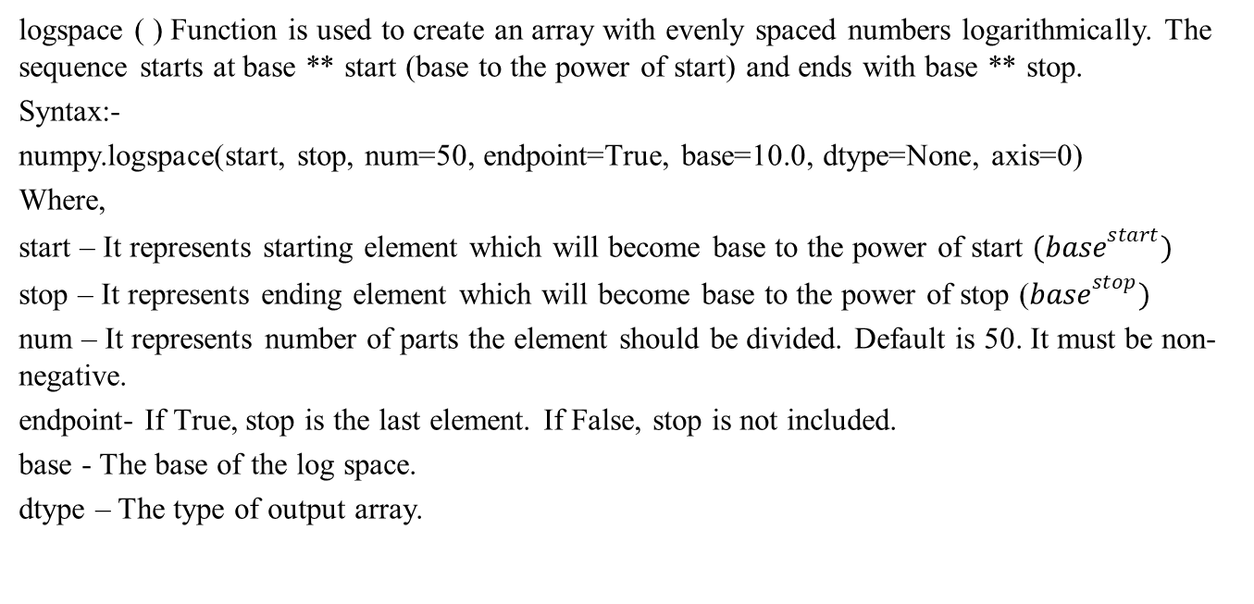
logspace ( ) Function
logspace ( ) Function is used to create an array with evenly spaced numbers logarithmically. The sequence starts at base ** start (base to the power of start) and ends with base ** stop.
Syntax:-
numpy.logspace(start, stop, num=50, endpoint=True, base=10.0, dtype=None, axis=0)
Where,
start – It represents starting element which will become base to the power of start ${(base}^{start})$
stop – It represents ending element which will become base to the power of stop (${base}^{stop})$
num – It represents number of parts the element should be divided. Default is 50. It must be non-negative.
endpoint- If True, stop is the last element. If False, stop is not included.
base - The base of the log space.
dtype – The type of output array.

Slide 2


Creating Array using logspace ( ) Function
Syntax:-
from numpy import *
array_name = logspace(start, stop, num=50, endpoint=True, base=10.0 dtype=None)
Ex:-
a = logspace(1, 3)
from numpy import *
a = logspace(1, 3)
a = logspace(1, 3, 5)
a = logspace(1, 3, 5, base=12.0)
$${10}^{1}$$
$${10}^{3}$$
10.0 | 31.62 | 100.0 | 316.2 | 1000.0
a[0] | a[1] | a[2] | a[3] | a[4]

Slide 3
Accessing One-D Array Elements
from numpy import *
a = logspace(1, 3, 5)
print(a[0])
print(a[1])
print(a[2])
print(a[3])
print(a[4])
10.0 | 31.62 | 100.0 | 316.2 | 1000.0
a[0] | a[1] | a[2] | a[3] | a[4]

Slide 4
Accessing using for loop
from numpy import *
a = logspace(1, 3, 5)
Without index
for el in a:
print(el)
With index
n = len(a)
for i in range(n):
print(a[i])

Slide 5
Accessing using while loop
from numpy import *
a = logspace(1, 3, 5)
n = len(a)
i = 0
while i < n :
print(a[i])
i+=1

